Slide 1
Nov 2023
Pipping Installation Recommendations

Slide 2
General Piping Requirements
Appropriate diameter pipe must be used for the Indalo system installation.
PN10 Pressure rated PVC piping or similar pipe and fittings should be used.
Keep piping runs as short as possible to minimize restriction.
Avoid excessive use of 45-degree and 90-degree fittings to minimize restriction.
Ensure that all piping is properly aligned and supported to avoid pipe strain on the pump, valves and equipment. Use pipe clamps if necessary to secure the pipe to the supports.
Add isolation valves before and after the Indalo system so that maintenance can be performed more easily, equipment can be removed without emptying the tank(s) and the discharge valve can be used to adjust the discharge pressure.

Slide 3
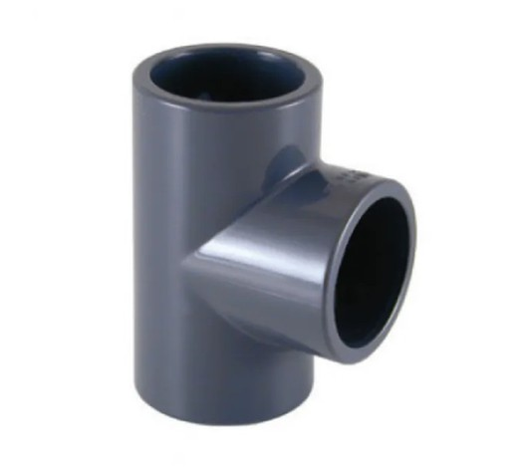
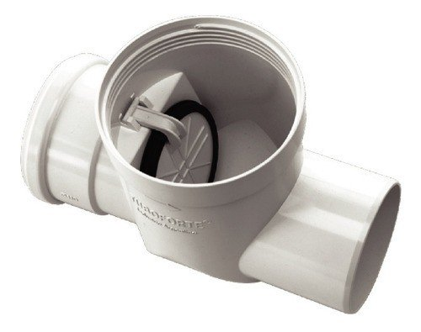
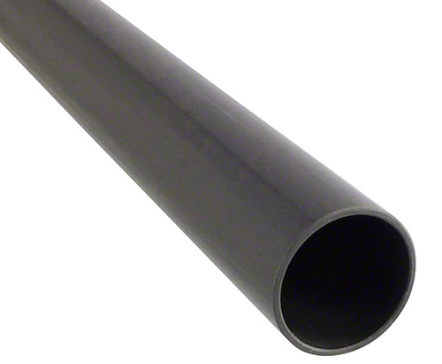
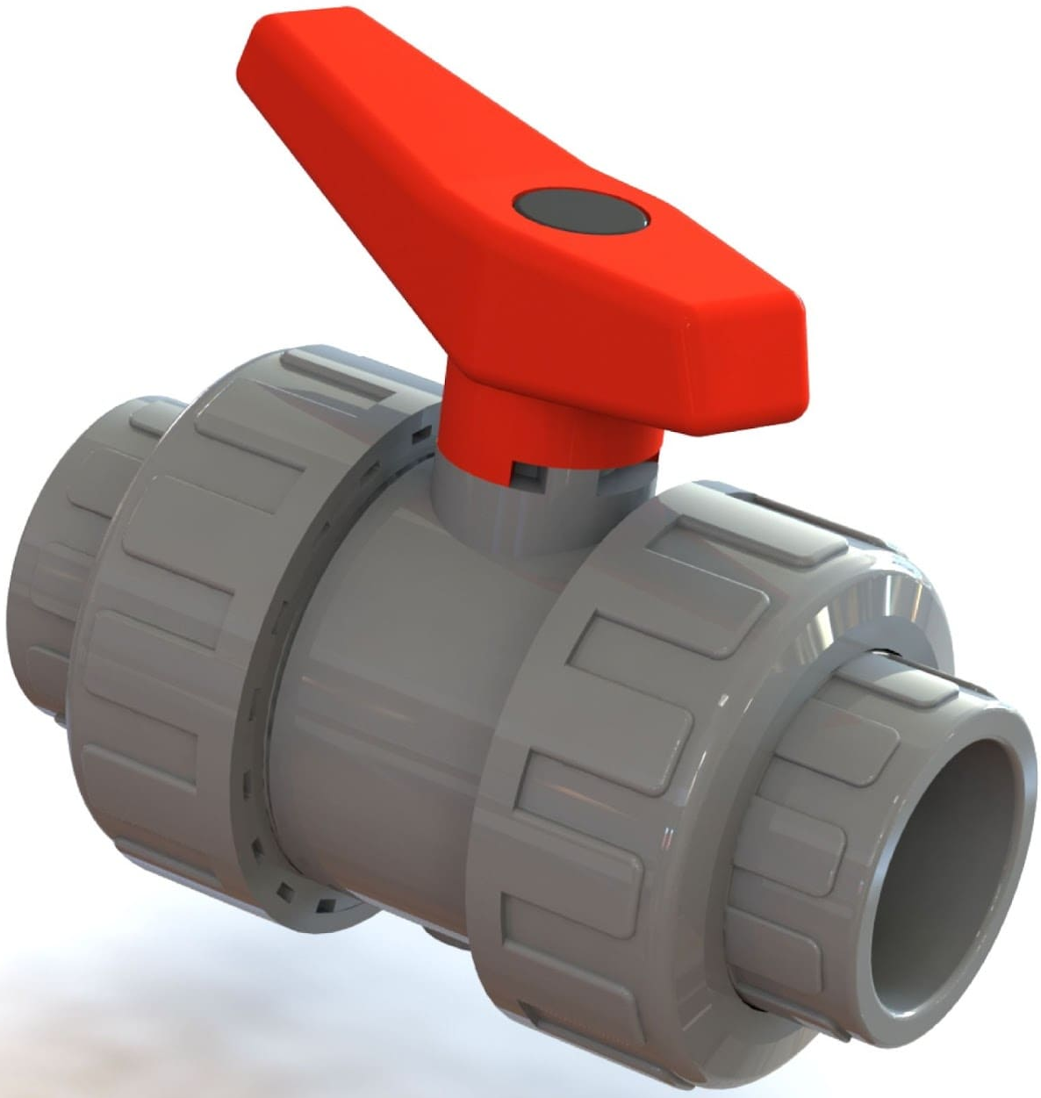
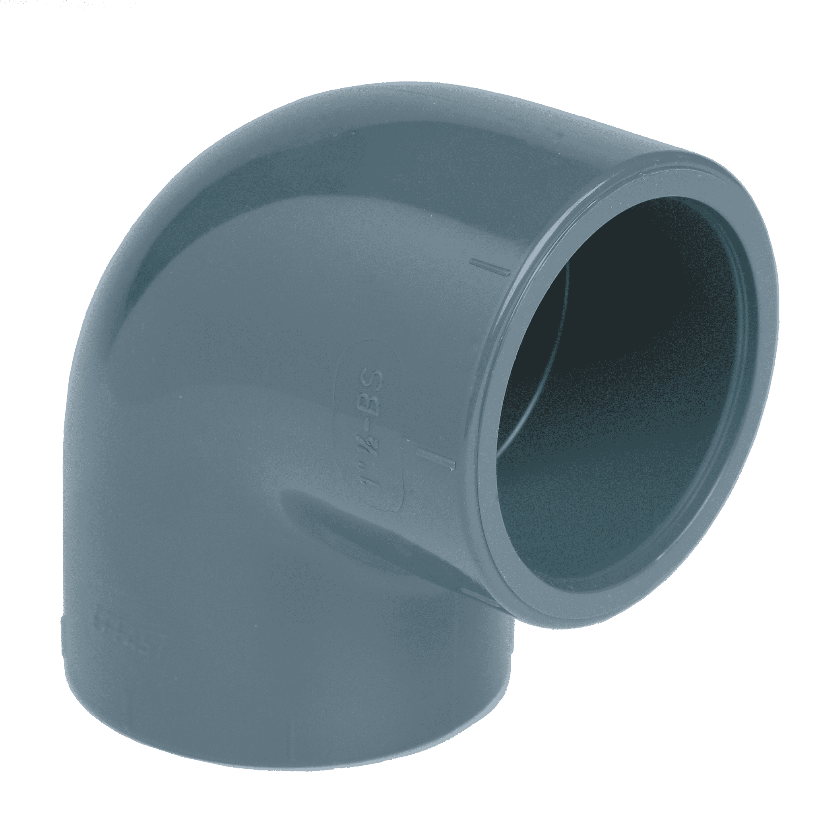
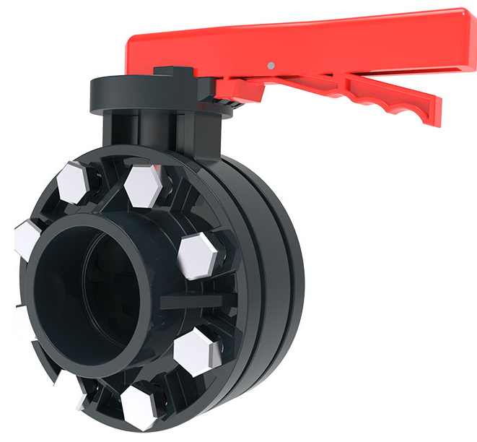
Piping Materials
Anti Return Check Valve
PN10 Pressure rated PVC
PN10 T PVC
Globe or Ball Valve
PN10 Pressure rated PVC
PN10 PVC Elbow

Slide 4
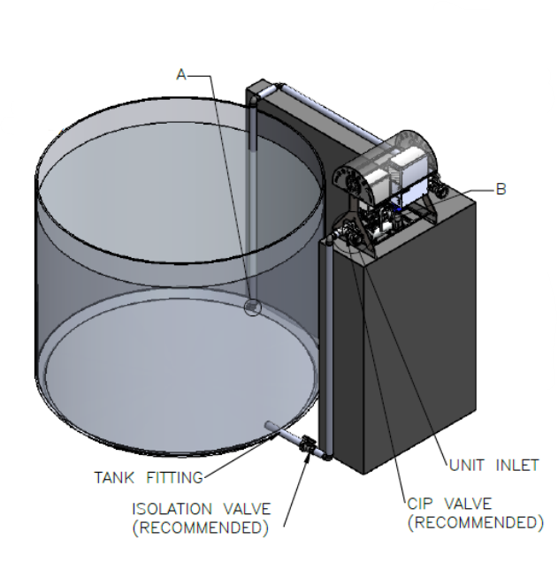
Suction Lift Installation
Suction lift is when the waterbody surface is below the centerline of the pump suction.
A self-priming pump or a priming tee in the highest part of the pipe is utilized to draw water up through the suction line and prime the pump for operation.
Install a PVC swing check valve or similar type check valve on the suction pipe in order to assist in priming the pump (A).
Do not exceed 2 meters of lift as measured from the water level to the pump inlet.
LOCATION OF THE PVC SWING CHECK VALVE
LOCATION OF THE PRIMING TEE

Slide 5
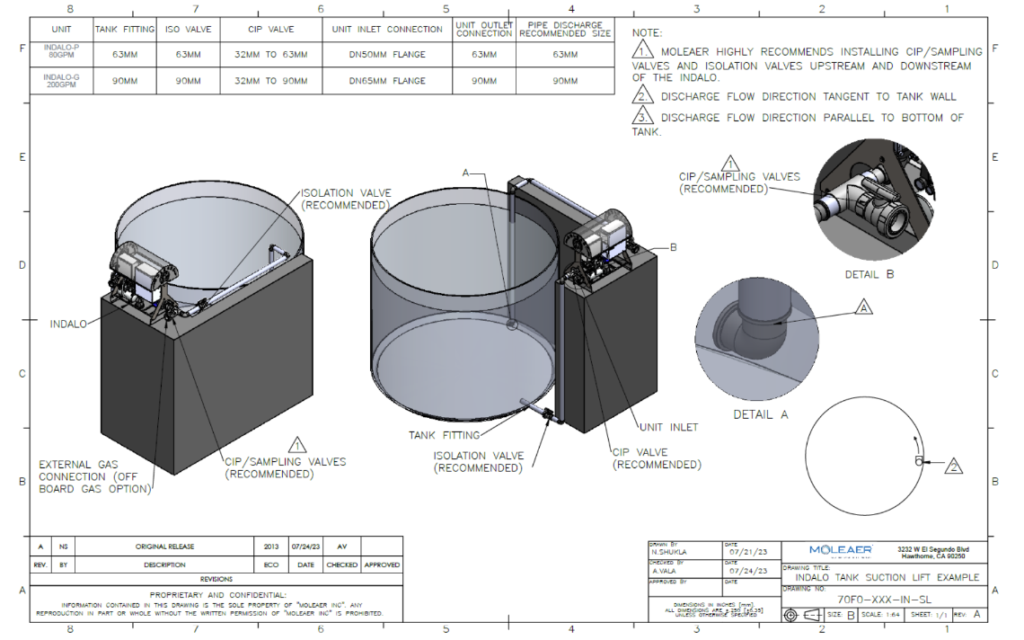
Suction Lift Installation
We recommend in A point, the discharge, to put a reduction from 63mm to 40 mm for Indalo P or from 90 mm to 63 mm for Indalo G.
Discharge pipe DN 63 (INDALO P) DN 90 (INDALO G)
Suction pipe DN 63 or DN75 INDALO P
Suction pipe DN 90 or DN 110 INDALO G

Slide 6
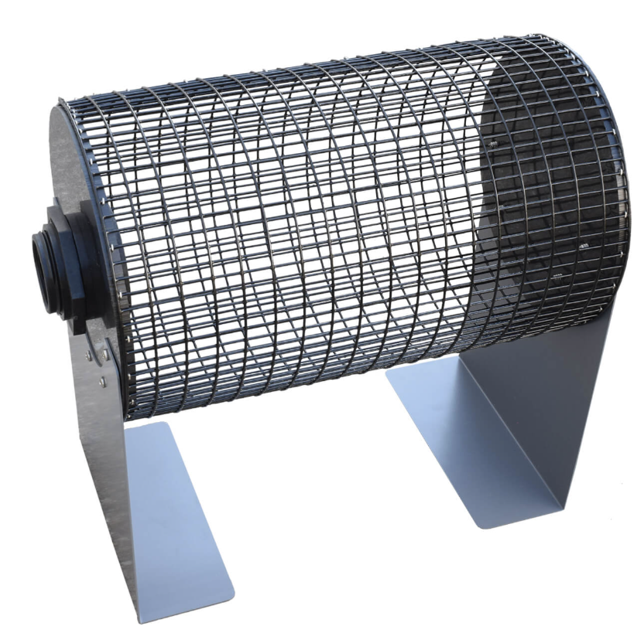
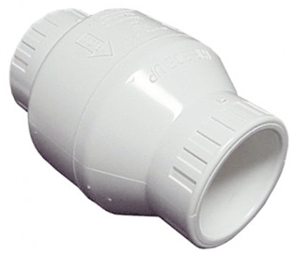
Suction Piping Installation Tips
Use fittings and pipe as necessary to route the intake piping from the tank or water body to the INDALO system pump inlet.
For installations where debris 6mm or larger in size is present, install a screen on the intake of the suction pipe to ensure that larger solids do not pass through the Indalo(see picture at right).
Keep suction piping as short as possible and avoid unnecessary bends
If your pump is being installed in a suction lift application, do not exceed 2 meters of lift as measured from the water level to the pump inlet. (Recommendation)
Run a length of straight horizontal piping to the suction side of the pump. Minimum length of this piping run should be at least five (5) pipe diameters
For suction lift installations, you must install a PVC swing check valve or similar type check valve on the suction pipe.
Install a "priming tee" with a ball valve on it at a location higher in elevation than the pump.

Slide 7
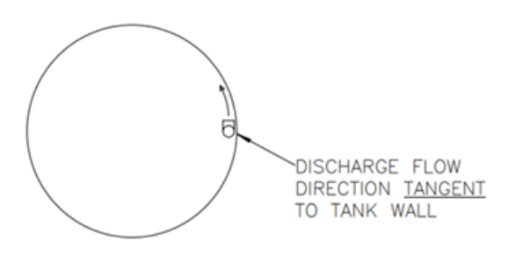
Discharge Piping Installation Tips
Use fittings and pipe as necessary to route the discharge piping from the Indalo system unit discharge connection to inside the receiving tank or receiving waters
Keep discharge piping runs as short as reasonably possible and minimize the use of 45-degree and 90-degree elbows.
Best practice is to install discharge pipe at the maximum depth reasonably possible but for sure low enough to prevent turbulence or splashing at the surface
If discharging into a tank, connect a 90-degree elbow to the end to angle the discharge flow along the wall of the tank to create a circular current to assist with mixing. (See picture at right)
Keep discharge as far away from the inlet pipe as possible but at a minimum 2 feet away.
A reduction at the end of the discharge pipe is recommended.

Slide 8
End of Training
Thank you for joining us today. We hope that you enjoyed the training!
Please feel free to contact me for additional information:
Igor Rello Sergio Diaz
Moleaer España SLU Moleaer España SLU
igor@moleaer.com sergio@moleaer.com
Mobile: +34 666537931 Mobile: +34 677928098

